Slide 1

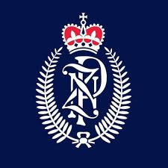

SQL
Project
Motor Theft Cases in NZ

Slide 2
Overview
Introduction 01
Objectives 02
Which regions has most motor theft cases? 03
Is there any pattern in theft with respect to vehicle type? 04
what are the yearly trends in motor theft cases in new Zealand? 05
Do motor theft cases depends on population density? 06
What are the distribution on theft cases on the basis of vehicle name? 07
What are the top stolen vehicle by location? 08
Recommendations 09
Thank You 10

Slide 3

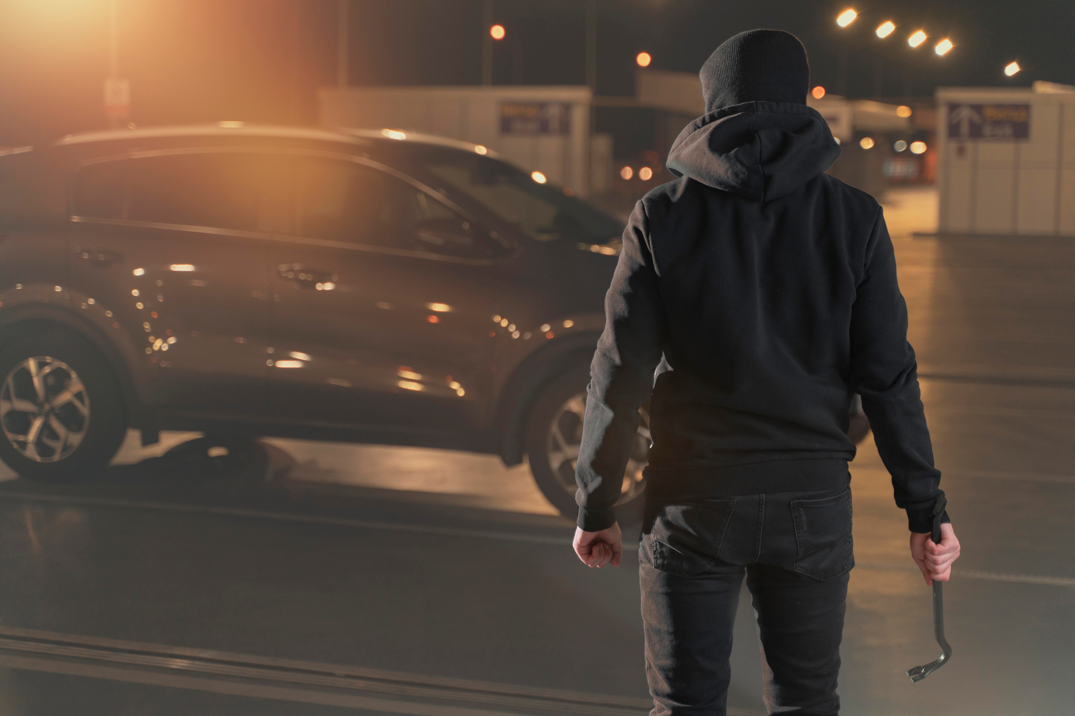

Introduction
This dataset contains information on stolen vehicles, their locations, and manufacturing details. It consists of:
Stolen Vehicles Data : Includes vehicle type, make, model year, color, date stolen, and location.
Vehicle Make Details : Lists vehicle manufacturers and their types.
Location Data : Covers theft locations with region, country, population, and density.

Slide 4
Objective:-
Target Group: 🚔 Police Department
Main Goal:
📊 Actionable Insights for Motor Vehicle Theft Trends in New Zealand

Slide 5
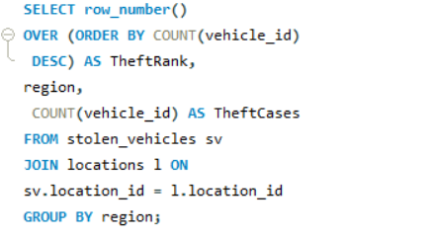
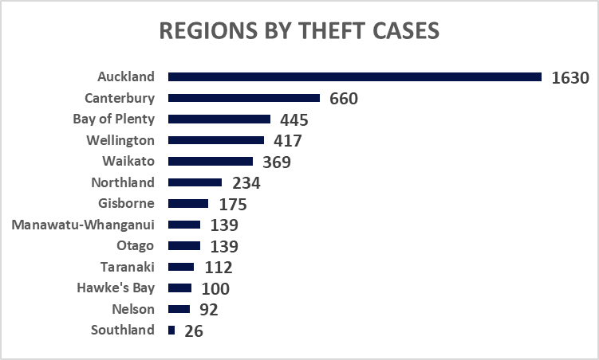
1. Which regions has most motor theft cases?
Auckland reports the highest number of motor theft cases (1,630), significantly higher than other regions, indicating a major hotspot for vehicle theft.
Canterbury (660) and Bay of Plenty (445) follow as the next most affected regions, suggesting higher crime rates in these areas.
Regions like Southland (26) and Nelson (92) have the lowest cases, possibly due to better security measures.
Overall, urban regions experience more theft cases compared to rural areas, likely due to higher vehicle density and increased criminal activity.

Slide 6
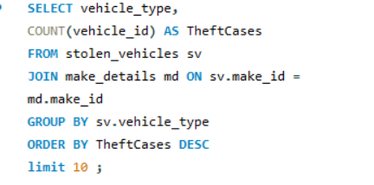
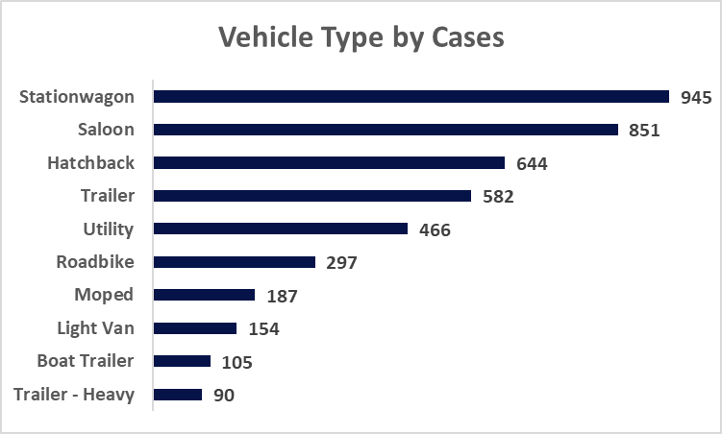
2. Is there any pattern in theft with respect to vehicle type?
Station wagons and Saloons are the most stolen vehicle types, with 945 and 851 cases, respectively, indicating that these are prime targets for theft.
Hatchbacks (644) and Trailers (582) also have high theft cases, suggesting that smaller, commonly owned vehicles and detachable trailers are at risk.
Utility vehicles (466) and Road bikes (297) follow, showing that both work-related and personal-use vehicles are being targeted.
Mopeds (187), Light Vans (154), Boat Trailers (105), and Heavy Trailers (90) have lower theft cases, likely due to lower availability and better security.
Overall, frequently used family and commercial vehicles are more prone to theft, possibly due to their high resale value and easy accessibility.

Slide 7
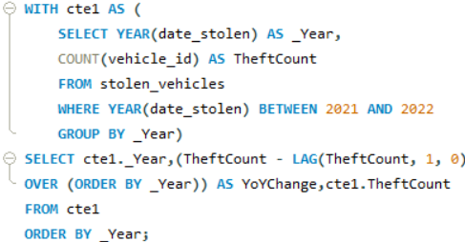
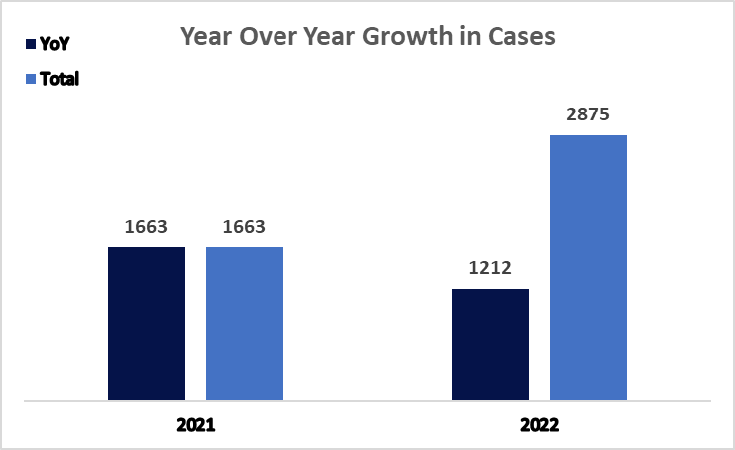
3. what are the yearly trends in motor theft cases in new Zealand?
Significant Increase in 2022: There was a sharp rise in 2022, with theft cases reaching 2,875, an increase of 1,212 cases compared to 2021.
Possible Reasons for the Surge: The increase could be due to a rise in criminal activities, changes in law enforcement reporting and economic factors.

Slide 8
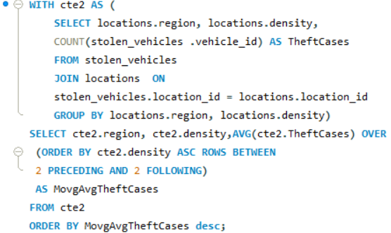
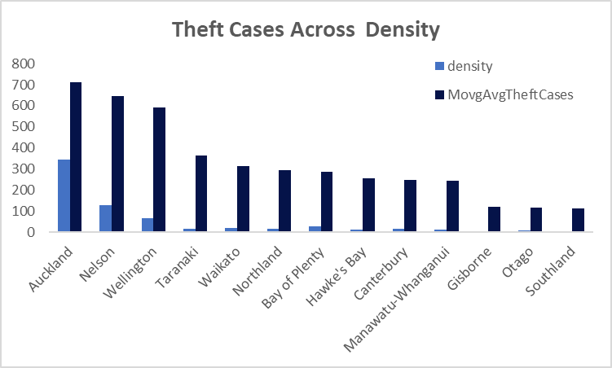
4. Do motor theft cases depends on population density?
Higher Population Density Leads to More Thefts: Auckland, Nelson, and Wellington, which have higher population densities, report the highest number of motor theft cases.
Moderate Density, Moderate Thefts: Regions like Taranaki, Waikato, and Northland show moderate theft cases, indicating a possible correlation between density and theft rates.
Lower Density, Fewer Thefts: Regions with lower population density, such as Gisborne, Otago, and Southland, have significantly fewer theft cases.

Slide 9
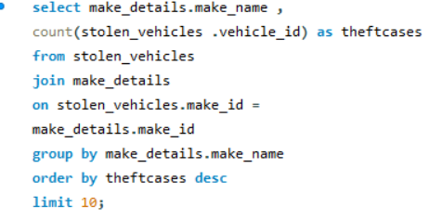
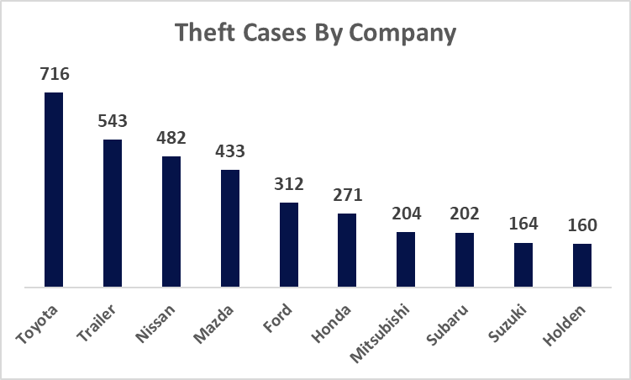
5. What are the distribution on theft cases on the basis of vehicle name?
Toyota has the highest number of reported theft cases, making it the most targeted vehicle brand.
Trailers also have a significant number of theft cases, indicating a demand for stolen utility vehicles.
Nissan and Mazda are among the top stolen brands, suggesting their popularity and lack of advanced security features.
Subaru, Suzuki, and Holden have relatively lower theft cases, which could be attributed to lower demand in the black market or has better security systems.

Slide 10
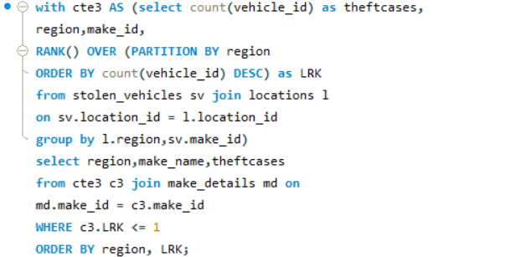
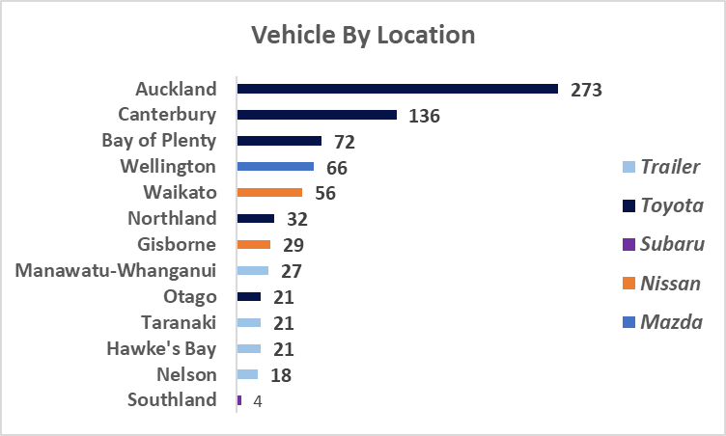
6.What are the top stolen vehicle by location?
Auckland (273 cases): Toyota is the most stolen brand.
Canterbury & Otago: Toyota remains the most targeted brand.
Bay of Plenty (72 cases) & Wellington (66 cases): Toyota and Mazda are commonly stolen.
Northland : Subaru is the most stolen brand.
Gisborne & Waikato: Nissan is the most stolen brand.
Taranaki, Hawke’s Bay, Manawatu-Whanganui & Nelson: Trailer is the most stolen brand.
Southland : Lowest theft cases still Subaru is the Most stolen Brand.

Slide 11
Recommendations:-
Focus on Auckland, Canterbury, and Wellington, as they have the highest theft rates.
Increase police patrolling and CCTV surveillance in theft-prone areas.
Promote secure parking zones with restricted access.
Encourage well-lit public parking areas and residential security measures.
Encourage vehicle owners to use GPS trackers, steering locks, and immobilizers.
Insurance companies can provide discounts for cars with security devices.
Deploy random vehicle checks in high-risk zones.
Implement AI-powered predictive policing using theft pattern analysis.
Run public awareness campaigns to educate vehicle owners.
Encourage neighborhood watch programs to monitor suspicious activities.

Slide 12



THANK YOU
For watching this presentation
Aniket Tiwari
+91 7439715261
tiwarianiket921@gmail.com

